Slide 1
SEED Presentation
Group 6 Wild swans

Slide 2
Introduction
Design a line following robot

Slide 3
solution concept
Robot with two front wheels run on Arduino
Raspberry Pi with computer vision to detect line
Communication between Arduino and Raspberry Pi

Slide 4
Sim and Control

Slide 5
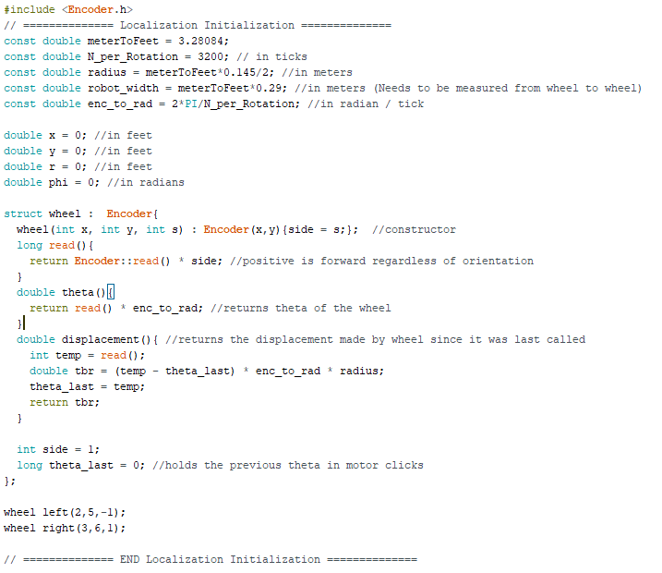
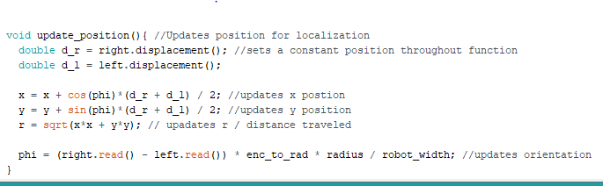
localization
Encoder.h
Useful constants
Wheel Setup
Encoder Interpretation
Position
X, Y, Phi, R
Notes:
We use the Encoder.h library to count the number of ticks made by the encoders in the motors/wheels.
The variables listed are needed or useful for determining the position. (meterToFeet converts a meter measurement to feet. Since we had better precision using metric on the meter stick we measured in metric. Radius and robot_width are needed to determine how much the bot has actually moved and turned. Enc_to_rad can be used to convert encoder readings into a radian value. Then position variables are initialized to 0.
A Wheel structure was made in order to keep code organized. It inherits the properties of an encoder class and adds some functionality to it: orientation interpretation (left side vs right), and variable storage for position interpretation. Two wheel objects are initialized to keep track of the wheels on the robot
Our position updates every iteration of void loop(). It takes the displacement made by the left and right wheels since it was last checked and uses these to calculate x and y. x and y are then used to calculate the total displacement made on the robots journey.
The phi is determined based on the wheel readings instead of updating. This is because the orientation can be determined solely off of how much each wheel has moved since the program began and leaves less room for any rounding error from update to update.

Slide 6
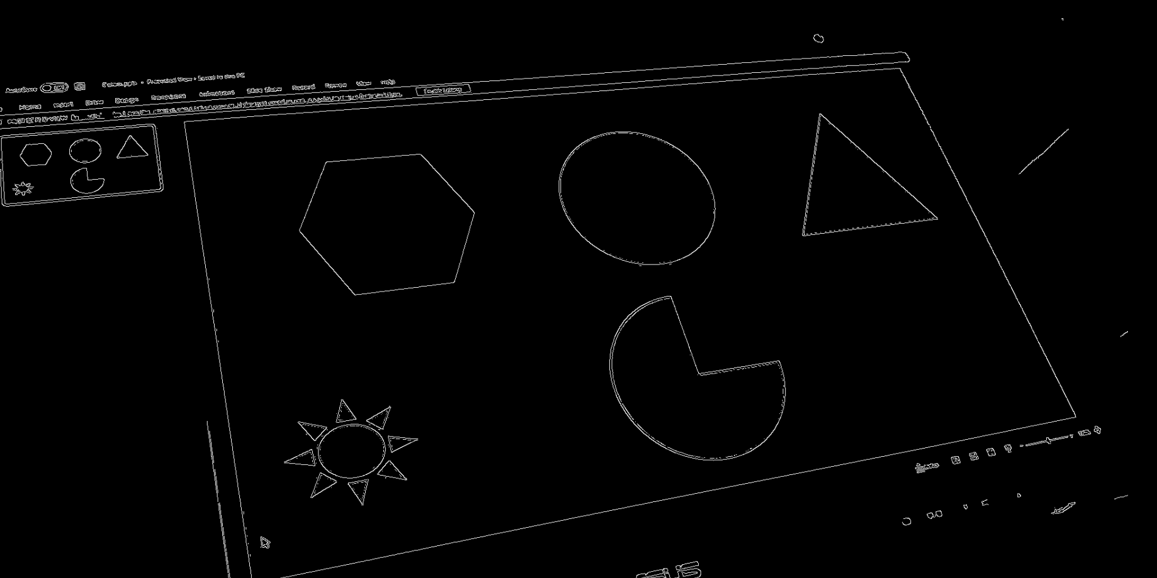
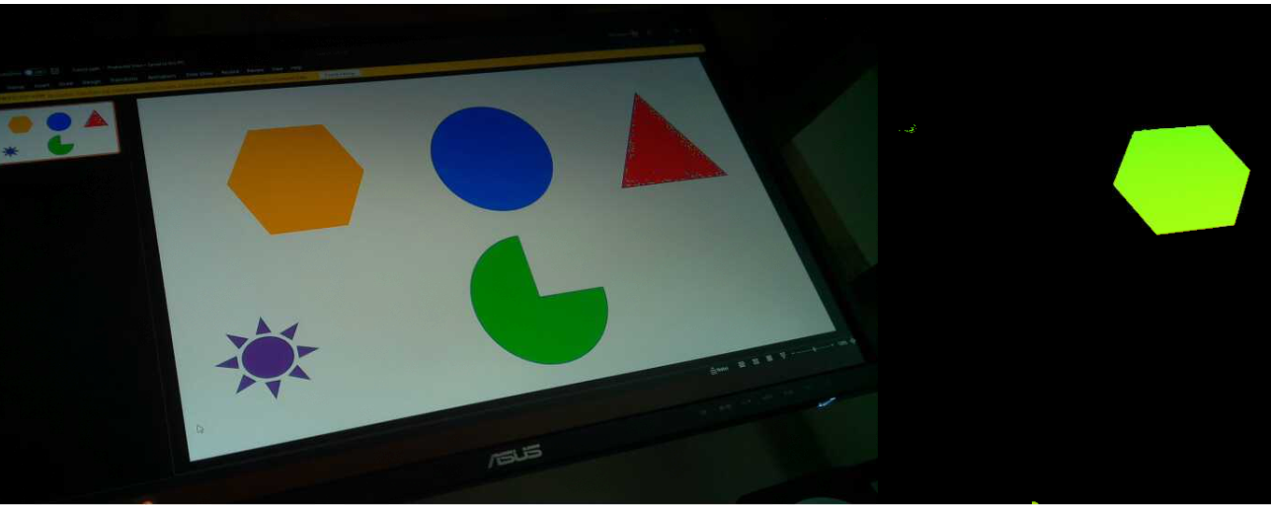
Computer vision
OpenCV
Color filtering
Distortion Correction
Contour Selection
Angle detection
Noise Reduction

Slide 7

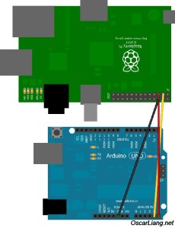
System integration
Sending data from Raspberry Pi to Arduino
I2C communication
Sending position or error of angles
LCD to display data such as position or angles

